Slide 1

Proposed Changes to
CVWD’s Landscape Ordinance
CVAG Technical Planning Subcommittee
November 23, 2015

Slide 2
Landscape Ordinance
Originally passed in 2009
Intended to ensure future water use is efficient
More stringent than the State of California’s requirements
Cities were required to adopt an ordinance
Some adopted CVWD’s
Others defaulted to the State

Slide 3
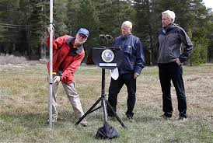
Governor’s Drought Actions - 2015
On April 1, Governor Brown issued Executive Order directing State Water Resources Control Board to impose mandatory statewide 25% reduction in urban water use through February 28, 2016
Required revisions of the Landscape Ordinance
Must be adopted by December…
Or February 1, 2016 if adopting a regional ordinance

Slide 4
CVWD Action
Staff has worked to revise the ordinance to ensure we align with the State ordinance.
Many changes were not necessary as we were already more stringent in some areas.
CVWD Board Agenda - November 24.

Slide 5
Changes to the Ordinance
Applicability:
Previously the ordinance and plan check applied to landscapes greater than 5,000 square feet.
Now it applies to landscapes greater than 2,500 square feet.

Slide 6
Changes to the Ordinance
Evapotranspiration Adjustment Factor (How we calculated the Maximum Applied Water Allowance):
Previously, the ordinance required an ET Adjustment Factor of 0.5.
Now, it requires an ET Adjustment Factor of 0.45.

Slide 7
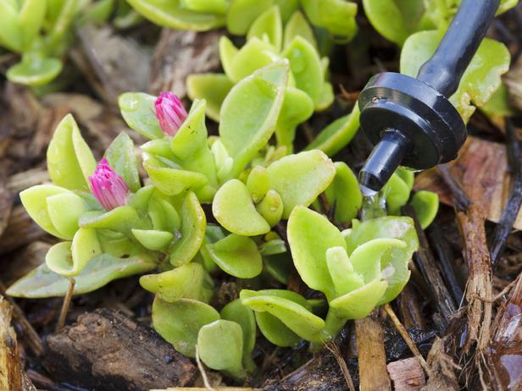
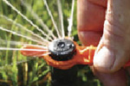
Changes to the Ordinance
Irrigation Efficiency Rates:
Previously, 75% efficient for spray irrigation and 81% efficient for drip irrigation
Now, 75% efficient for spray irrigation and 90% efficient for drip irrigation

Slide 8
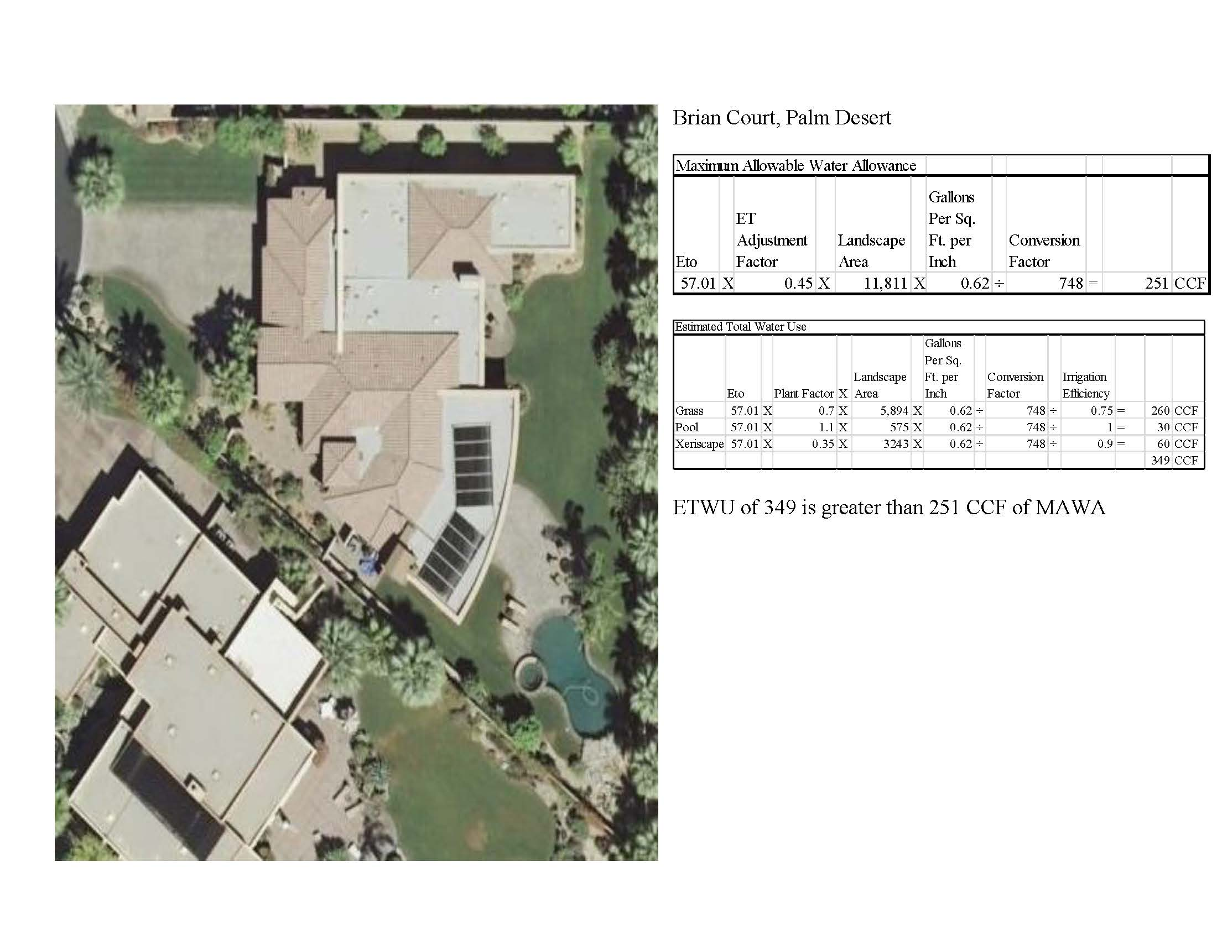

Slide 9
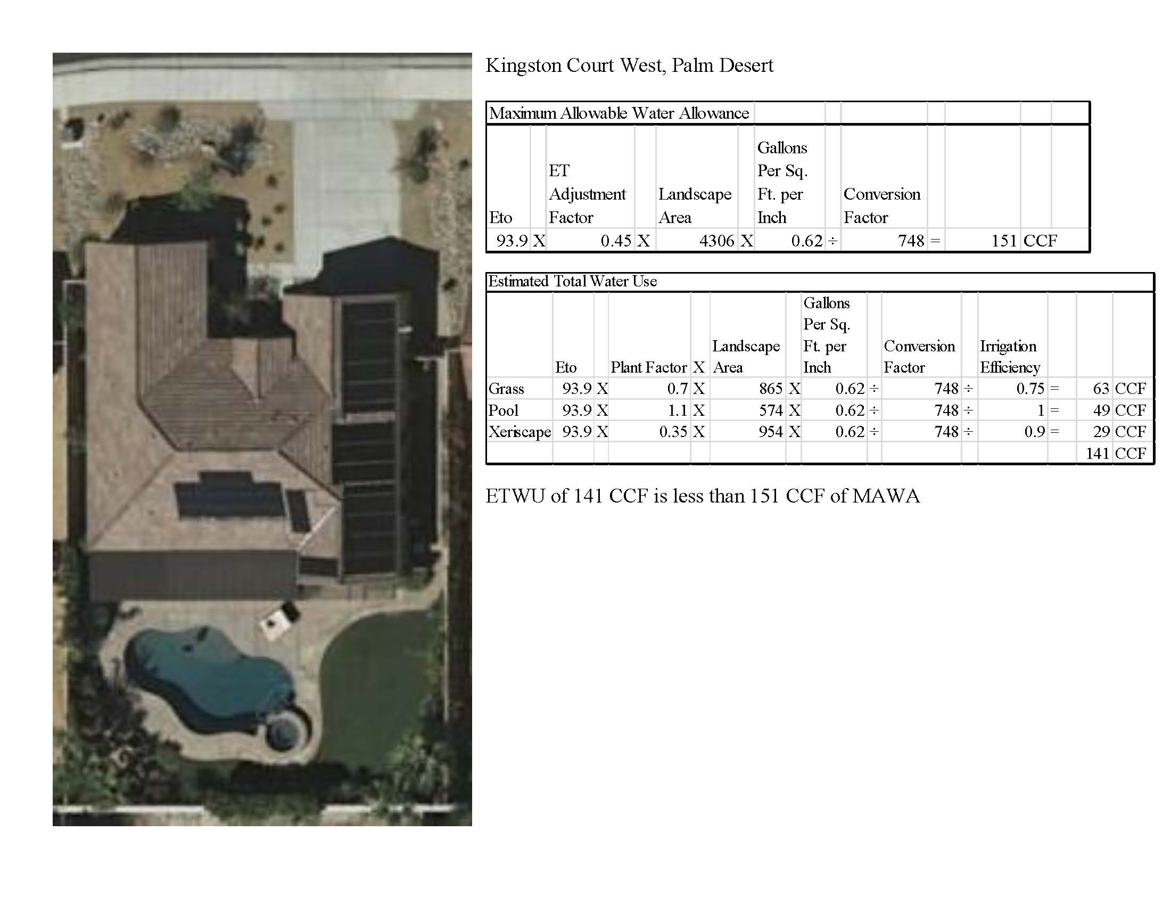

Slide 10
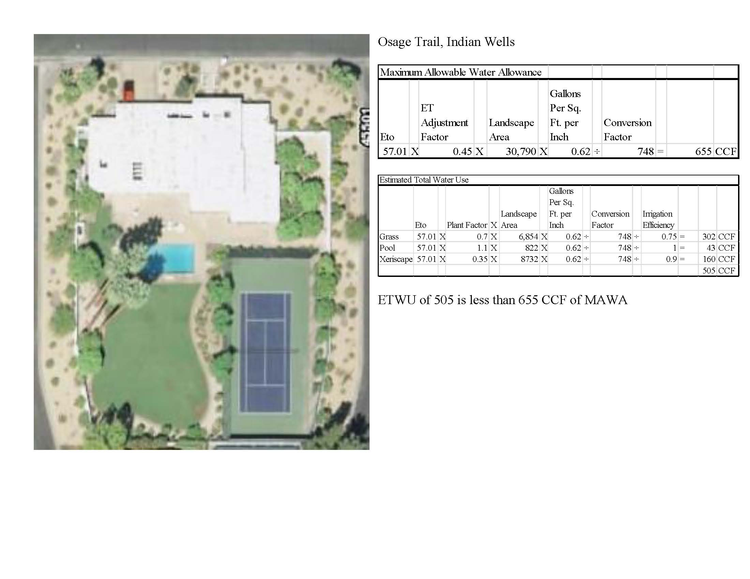

Slide 11
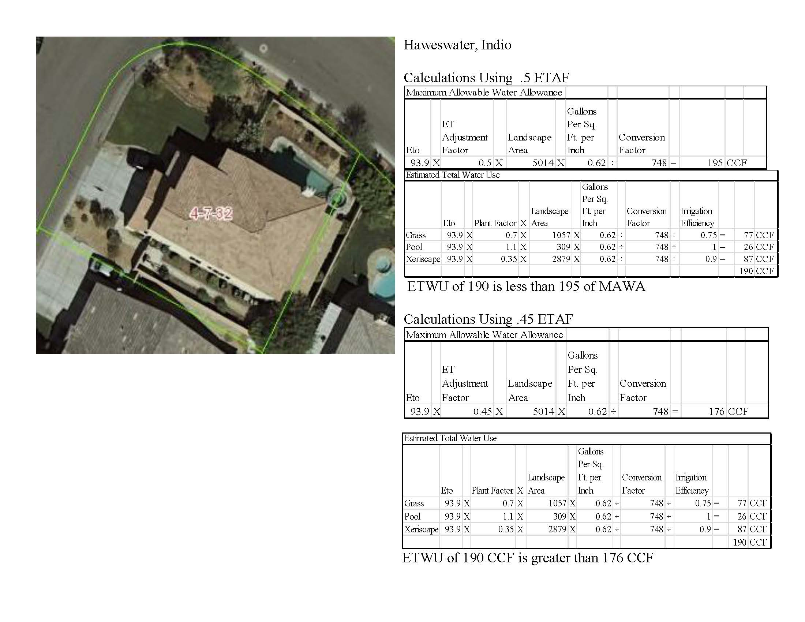

Slide 12
Changes to the Ordinance
Narrow areas:
Previous, areas less than ten feet in width must be irrigated with subsurface irrigation or other means that produces no runoff or overspray.
Now, long, narrow or irregularly shaped turf areas shall not be designed and areas less than ten-feet in width will be allowed if irrigation design reflects the use of subsurface irrigation or a surface flow/wick irrigation system.

Slide 13
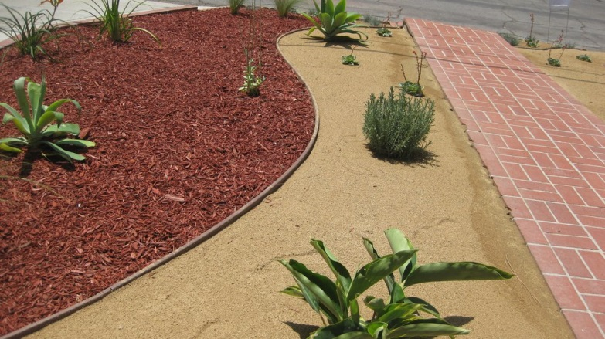
Changes to the Ordinance
Mulch:
Previously, the ordinance required at least 2 inches of soil covering mulch.
Now, the ordinance will require at least 3 inches of mulch.

Slide 14
Changes to the Ordinance
Landscape Meters:
Previously, required except for single family homes.
Now, required for single family homes except homes with a landscape area less than 5,000 square feet.
Can be serviced by the district or sub-metered.

Slide 15
Changes to the Ordinance
Flow sensors:
Previously, flow sensors were required for all projects except single and multifamily.
Now, they are required for all projects where a dedicated landscape meter is required.

Slide 16
Additions to the Ordinance
Easements:
No permanent structures or trees within CVWD and/or USBR (US Bureau of Reclamation) easements. No trees shall be installed within 15' of a CVWD and/or USBR pipeline.
Surface improvements may be installed within CVWD and/or USBR easements only upon the prior consent of CVWD

Slide 17
Additions to the Ordinance
Overhead irrigation will not be permitted within 24-inches of any non-permeable surface.
There are no restrictions on the irrigation system type if the landscape area adjacent is permeable and no overspray and runoff occurs.

Slide 18
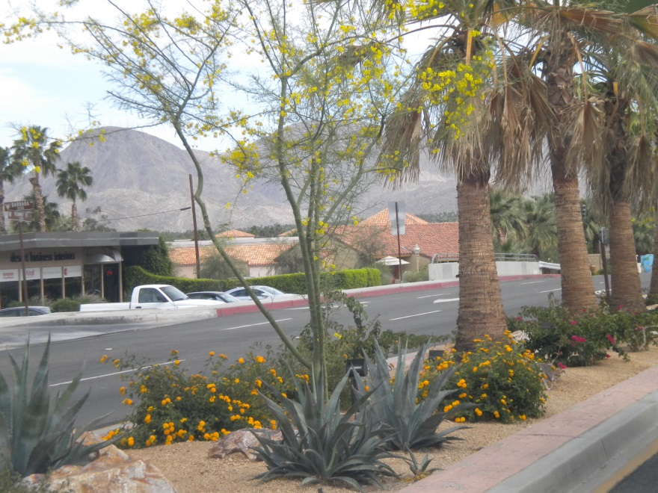
Additions to the Ordinance
Medians:
High water use plants are prohibited in street medians

Slide 19
Timeline for Ordinance Adoption
State deadline: February 1, 2016
If ordinance not adopted by then, state ordinance temporarily in effect
First and second reading for ordinance
CVWD ordinance will go into effect Dec. 1 if approved by CVWD Board this week
CVAG will provide sample staff report, resolution, support as needed

Slide 20
Drought Response
Changes from this week’s Board Action

Slide 21
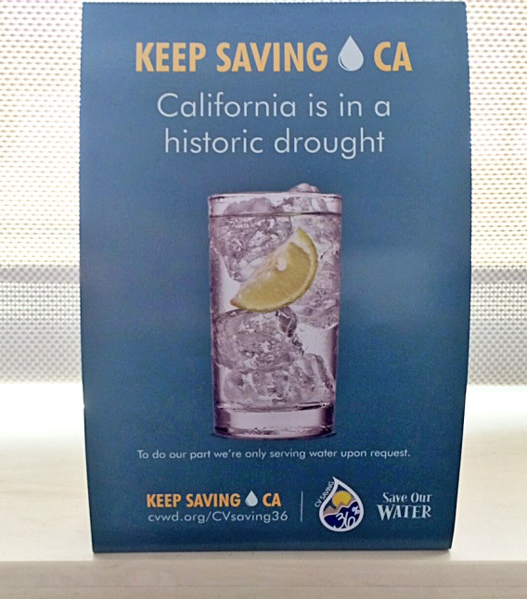
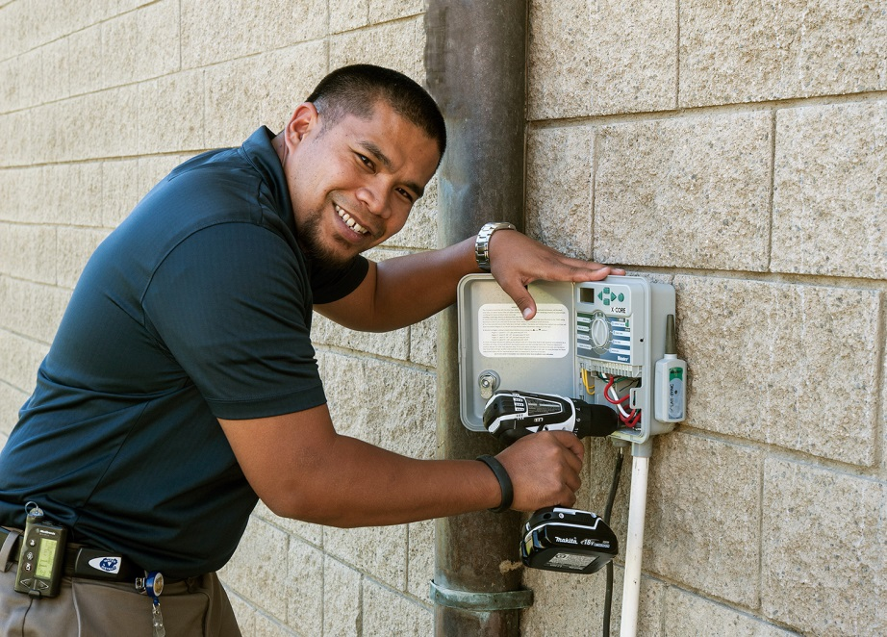
Past Response
Adopted Stage 3 Water Shortage Contingency Ordinance on May 12, 2015
Adopted state’s water-use restrictions and local restrictions and recommendations
Adopted Drought Penalties effective July 1, 2015
Increased funding for conservation programs
Increased Water Management staff level
Enhanced public outreach and education

Slide 22
Conservation Results
Notes:
Most of our customers have reduced water use significantly;
I’m pleased to report our Oct. reduction, our second best month since the official reporting period began
This brings our five-month average to 27%; a data point the state is judging us by (36%)

Slide 23
Conservation success
Top Water Savers in the State by gallons
 | Gallons saved June – Sept.
1. LA Department of Water and Power | 13,192,746,725
2. East Bay MUD | 7,842,500,000
3. San Jose Water Company | 7,081,900,000
4. City of Fresno | 6,174,789,448
5. City of San Diego | 5,990,876,241
6. City of Sacramento | 5,676,000,000
7. Coachella Valley Water District | 4,285,793,479
Notes:
Another metric from the state ranking agencies by volume of water saved.
CVWD ranks 7th of 412 water suppliers in the state in terms of gallons of water saved
This chart shows June through September.

Slide 24
Future Savings Potential
If all penalty consumption was eliminated, we would meet the 36% conservation mandate.
1 Ccf = 748 gallons
Notes:
Last meeting, question was asked “If all customers limited their water use to below their drought budget, would we meet our 36% conservation mandate?”
Yes

Slide 25
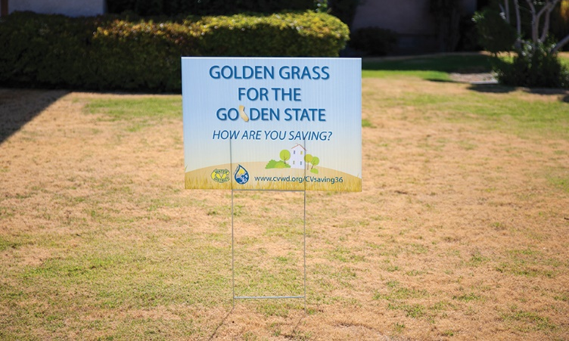
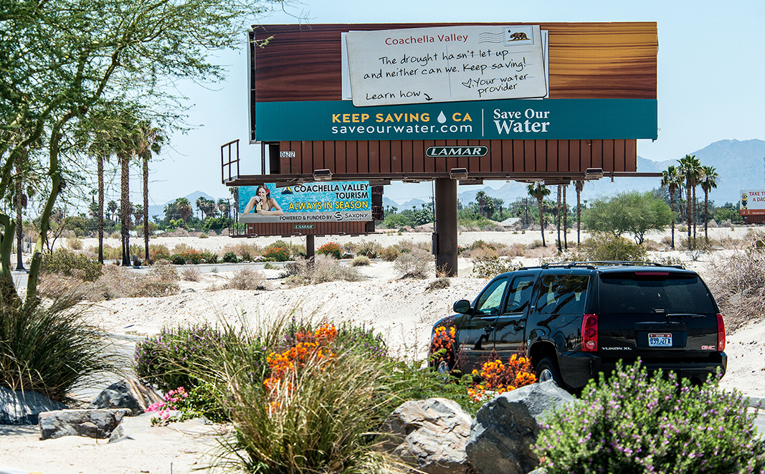
Proposed Next steps
Increase funding for conservation programs
Increase public outreach
Adopt new restrictions
Increase Drought Penalties

Slide 26
Drought Penalties
Budget Based Tiered Rates with a Drought Penalty for not reducing water use 36% |  |  |  | Drought Penalty Per Ccf
Tier 1: Excellent | 10 Ccf | $1.01 |  | $0
Tier 2: Penalty | With 36% less water use | $1.12 |  | $0
 | Without 36% less water use | $1.12 | + | $2.51
Tier 3: Inefficient | 105 – 150% of budget | $1.68 | + | $3.34
Tier 4: Excessive | 150 – 250% of budget | $2.24 | + | $5.01
Tier 5: Wasteful | Over 250% of budget | $4.48 | + | $10.03
Did not change budgets and rates within Tiers
Encourages reducing outdoor water use by 36%

Slide 27
Drought Penalties
Budget Based Tiered Rates with a Drought Penalty for not reducing water use 36% |  |  |  | Drought Penalty Per Ccf | Proposed New Drought Penalty
Tier 1: Excellent | 10 Ccf | $1.01 |  | $0 | $0
Tier 2: Penalty | With 36% less water use | $1.12 |  | $0 | $0
 | Without 36% less water use | $1.12 | + | $2.51 | $2.51
Tier 3: Inefficient | 105 – 150% of budget | $1.68 | + | $3.34 | $6.68
Tier 4: Excessive | 150 – 250% of budget | $2.24 | + | $5.01 | $15.03
Tier 5: Wasteful | Over 250% of budget | $4.48 | + | $10.03 | $40.12
Increases proposed for only top three Tiers

Slide 28
Presentation Prepared by: Katie Ruark
Conservation Manager
Coachella Valley Water District
kruark@cvwd.org

